Slide 1


The Sweetspot Discovery
Light on sugar.
Big on taste.
Cédric Sax / Alessandro Hofmann
+41 79 768 65 08 / +41 79 275 82 12
cedric@potiio.ch / alessandro@potiio.ch
www.potiio.ch
Christoph Hartmann
29.03.2022
The information within this slide deck is confidential and meant only for use by the intended recipient(s). Disclosure or copying is strictly prohibited.

Slide 2

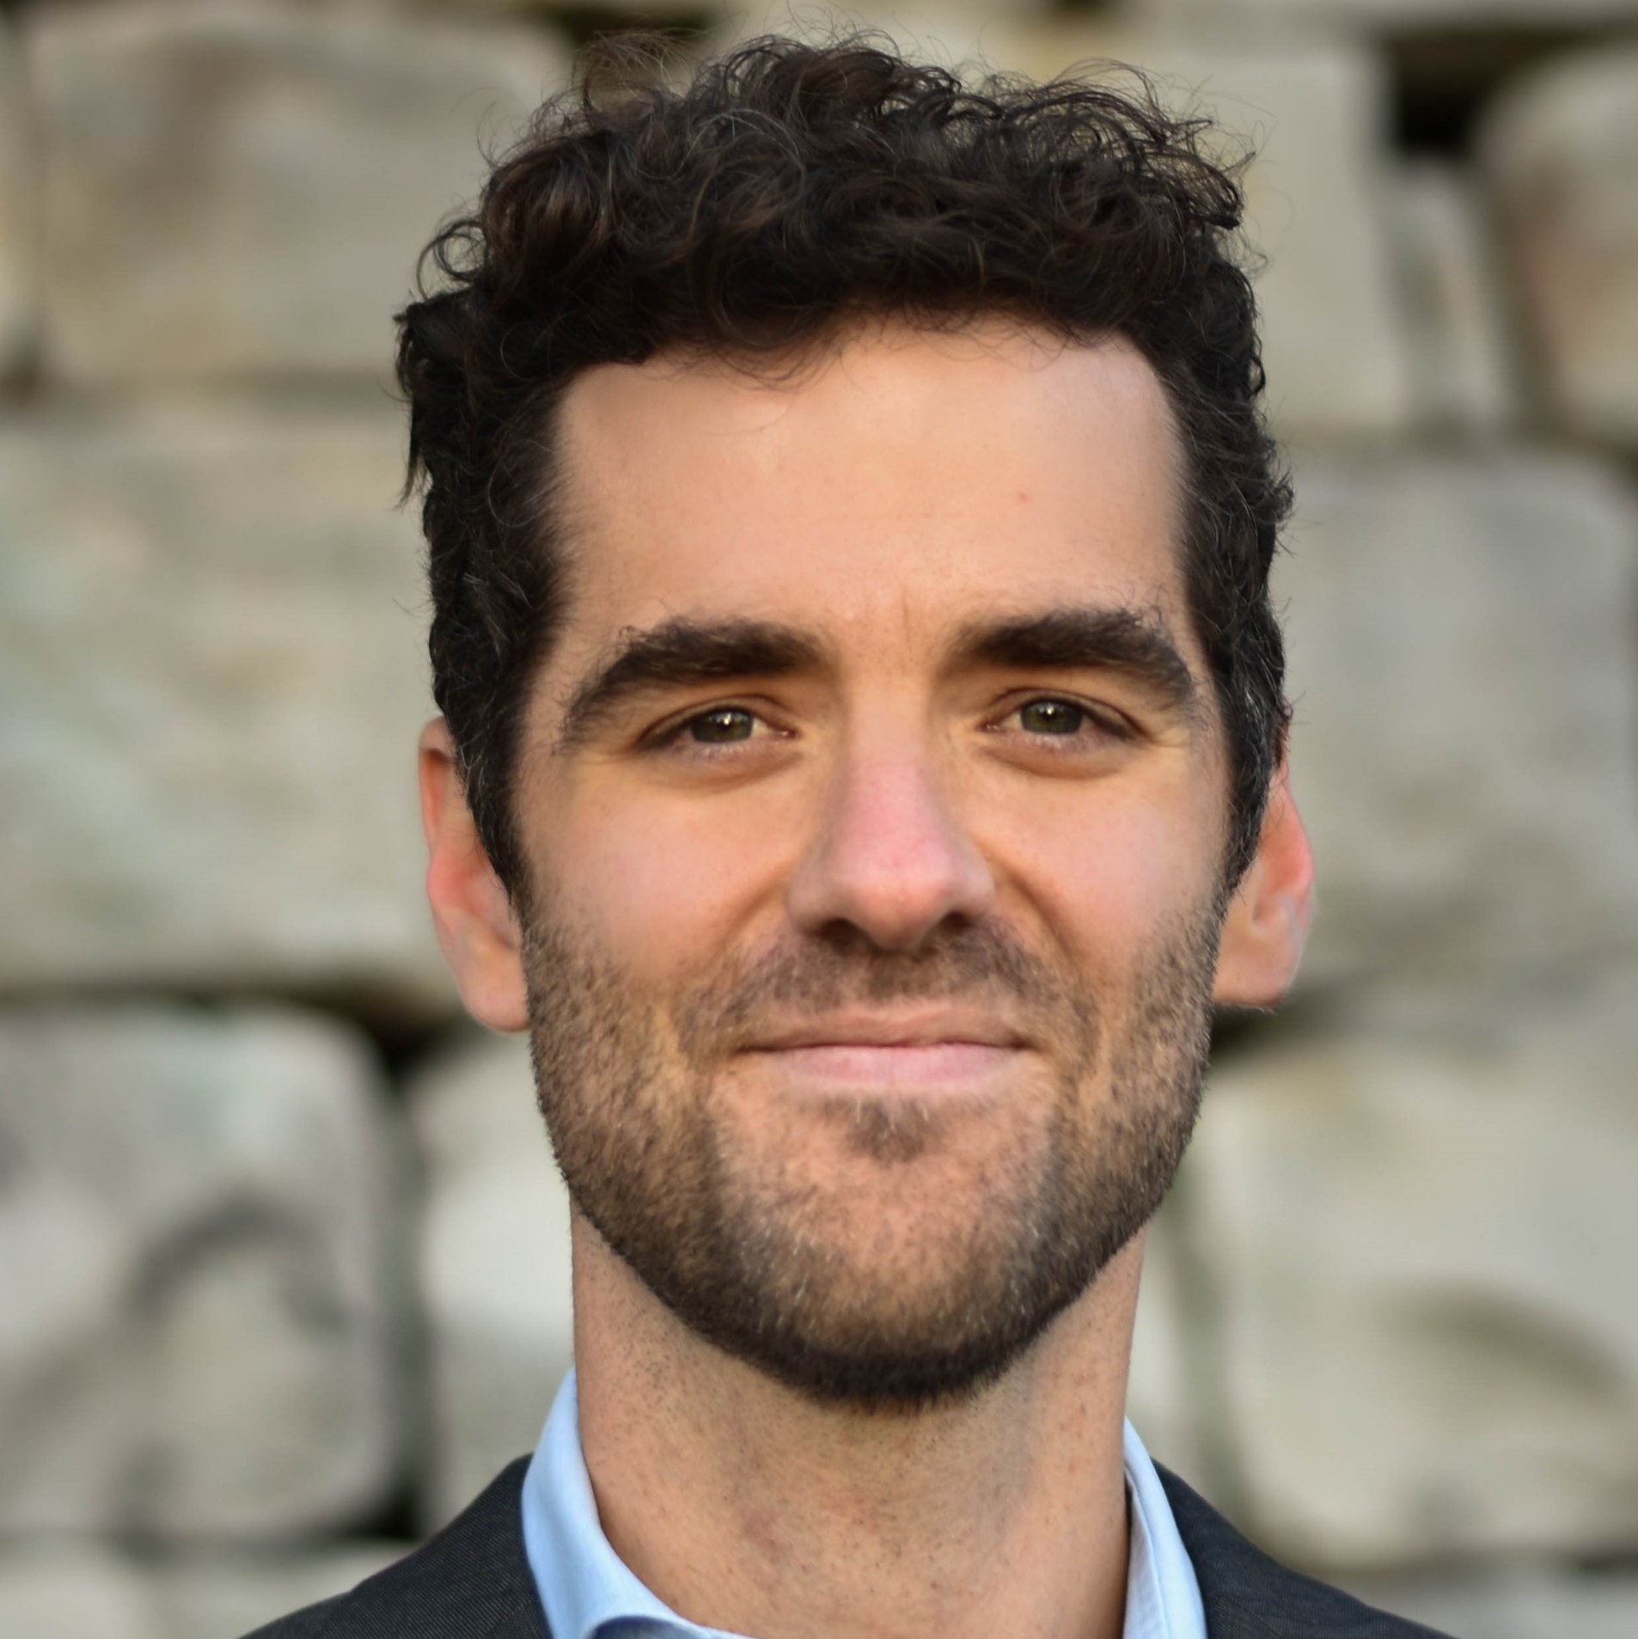

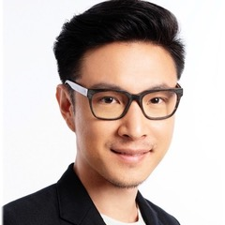

Team
Cédric Sax
Co-founder / CEO
Alessandro Hofmann
Co-founder / Business development
Anurak Supornpraditchai
Product development
Consulting / Project management
PhD Materials Science
Meat analogue development
Startup myTAMAR: Founders Associate
Relationship Manager Private Banking
BSc Banking and Finance
Industrial designer
Chef / cook
Prof. Erich Windhab
Head of the laboratory of food process engineering, ETH
Paola Ghillani
CEO Paola Ghillani & Friends AG
Innosuisse Coach
Migros Board Member
Dr. Peter Braun
CEO Swiss Food Research
Andreas Weckherlin
Strategic innovation & Business transformations
Managing Director & Board Advisor
Notes:
Potiio has: Minimal sugar
Original sweetness
Modern product
No traction
No production

Slide 3



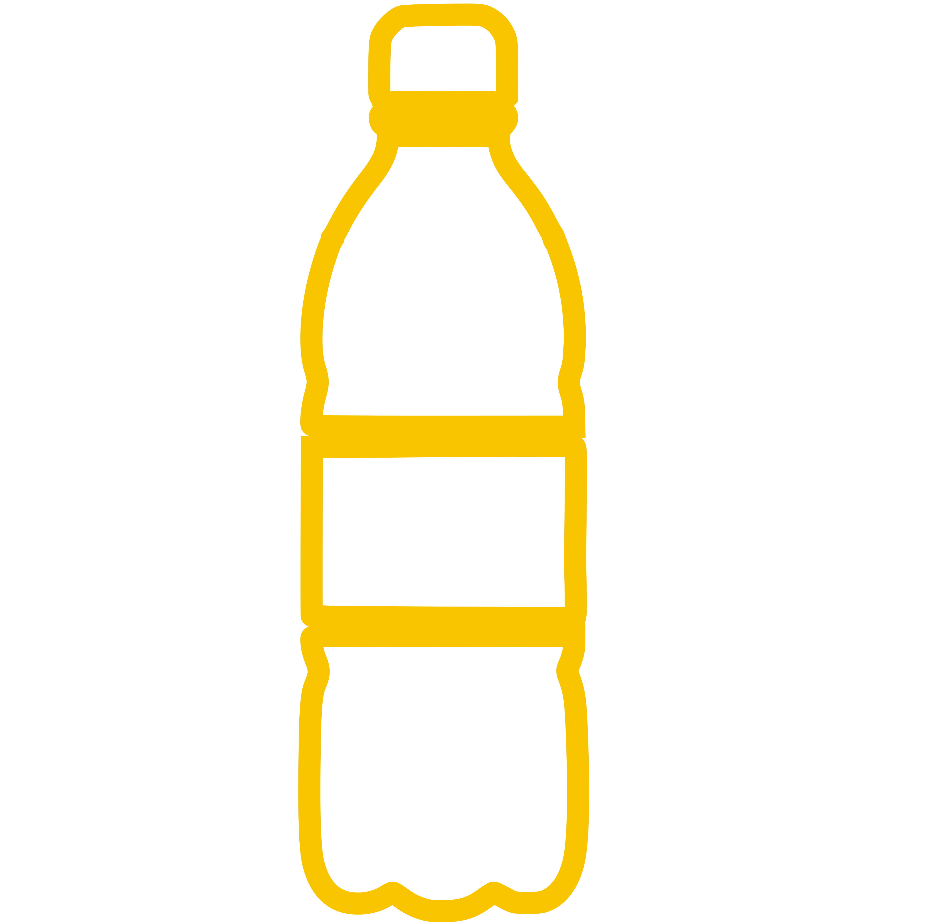

Unhealthy drinking habits throughout the day
Energy drink to stay awake
120 kcal
Soft drink with lunch
190 kcal
Protein drink after sport
200 kcal
1 x wake up milk coffee and 1 x milk coffee to go
Alcoholic drink
Total
260 kcal
230 kcal
1000 kcal
Notes:
1.punkt, coffee on the go, nespresso kaffe
Our Vision statement:
Taste and senses refill healthier hydration endlessly and mindfully.

Slide 4
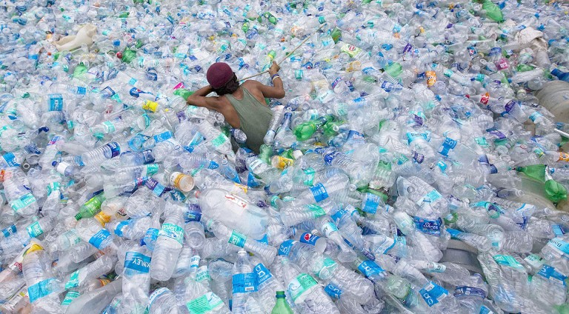
PET Bottle waste
1 Mio PET bottles per min produced worldwide – Only 9% recycled
Notes:
1.punkt, coffee on the go, nespresso kaffe
Our Vision statement:
Taste and senses refill healthier hydration endlessly and mindfully.

Slide 5
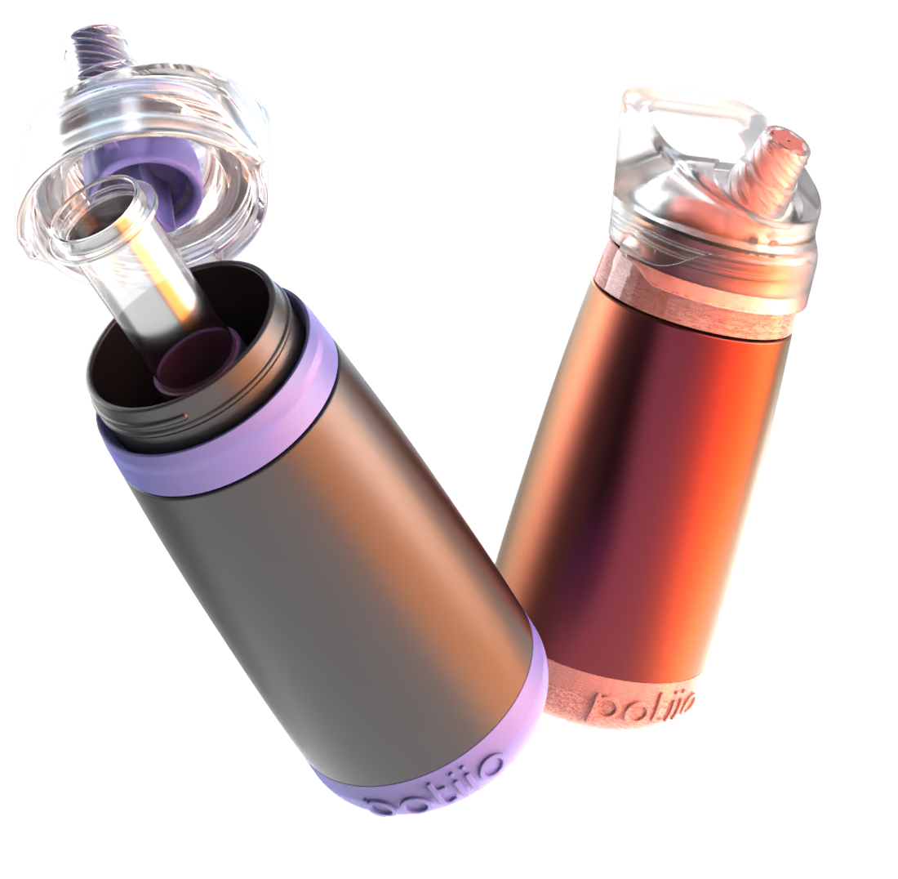

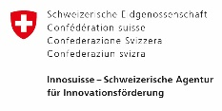





The potiio bottle
– 40% Calories
0% Artificial sweeteners
Various capsule flavors
– 75% CO₂

Slide 6
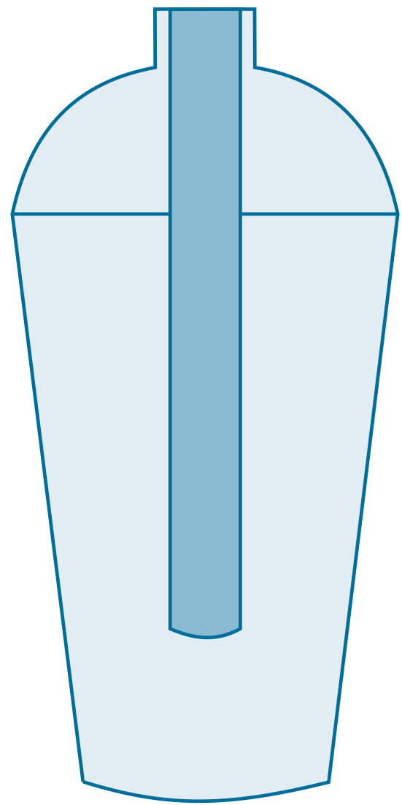
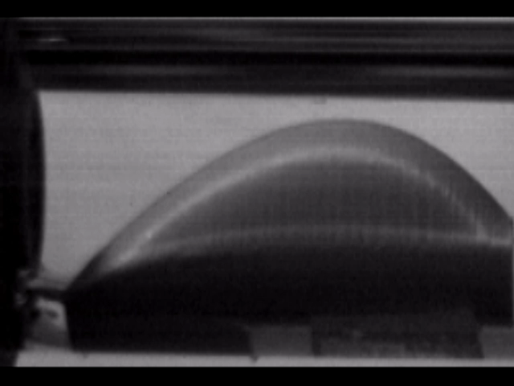
A reusable drinking system with an innovative capsule system
  Experiment: Sugar reduction of 40% does not reduce the sweetness perception.
patent pending
1
Optimized volume of soft drink sirup
– Recyclable capsule
  Mouth model – a sip out of the potiio-bottle
2
Delayed release of pure water
– Reusable bottle
3
Repeat for continuous drinking
  potiio bottle

Slide 7
One day in life – with a potiio-bottle
Low-sugar soft drink for motivation
Liquid boost to stay focused
First product
Tasty drink to optimize digestion
Drink to stay hydrated
Regeneration after sport
Total sugar / calorie savings
Nutritious beverage to energetically start the day
40%
Notes:
Our Vision statement:
Taste and senses refill healthier hydration endlessly and mindfully.

Slide 8


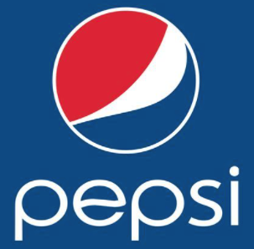





Competitive landscape – Second mover advantage with potiio’s capsules
  potiio’s market opportunity
  Blue ocean with flavors
  Room for new products
  Room for innovation
  Less risk of product acceptance
  Better customer services
*potential partnerships
high
*
*
*
Increasing sweet sugar taste
none
Calories
high
none
Notes:
Unser Wettbewerbsumfeld seht ihr in dieser aufgelisteten Grafik: (Hauptfokus auf airup – soll hier erst von allem getestet werden?), nur wenn Fragen auftauchen, erklären.
Potiio has: Minimal sugar
Original sweetness
Modern product
No loss of taste
In einem weiteren Schritt alle second-mover advantages aufzählen

Slide 9

The circular business of capsules and bottles
  Soft drink innovation
CAPSULES
Sale: CHF 1.50
≈ Margin: CHF 0.40
  B2C
BOTTLES
Market Size EU:
Sale: CHF 48.-
CHF 127B
≈ Margin: CHF 40.-
COLLABORATION
  Circular economy
  Quickly access new markets
Notes:
Mit unserem Produkt streben wir ganz klar den B2C Markt an mit einem Kreislaufwirtschafts-Ansatz: Die Strategie von potiio ist es, den Kreislauf durch Smart Design und die Nutzung von Materialien aus nachhaltigen Quellen zu schließen. Unsere Ambition lautet: Alle Verpackungen zu 100 % recycelbar oder wiederverwendbar machen; fossile Kunststoffe um 50 % verringern und „Zero Waste“ zu erreichen.
Recycable and sustainable. Customer will consume on average 40 capsules per year (eher konservativer Ansatz, wenn man bedenkt, dass z.B. Espresse pro Koknsument mit 300 Kapseln p.a. rechnet)
Reusable and potable bottle. Sustainable material. Possible cap system (hier sind wir im Aufbau unserer Supply Chain)
Joint ventures with soft drink companies (um Awarness zu steigern und eventuelle Kooperationen mit Kapselgeschmäckern einzugehen)
Kosten Kapseln: 0.30 Rappen und Flasche: 8.- (ohne Mold und Maschinenaufwand)

Slide 10

Timeline – Crowdfunding & test market in 2022
Launch online store
CH retail test market
5 capsule variations
Expand into DACH
Pre-Seed Funding 1.25 Mio CHF
> 160’000 customers
Hypergrowth
2021
2022
2023
2024
2025
Achieved Milestones
InnoSuisse project
Patent registration
3 FTE
Prototype ready
Crowdfunding
Product line expansion
EU expansion
Partner with soft drink company
370’000 customers
30 Mio + sales
New market penetration
Notes:
FTE im 2023: Hauptsächlich Marketing und Sales (und Product Developer)

Slide 11
Next steps – Marketing / Crowdfunding 2022
Product Market Fit
«middle» investors
Early investors
«late» investors
April
Mai
Juni
Juli
August
Dec
Willingness to buy:
69%
Strategy Crowdfunding
Maximizing
Awareness
Crowdfunding DACH
Marketing Concept
Further contacts with VC’s
Survey with 1081 applicants
Video production MVP
30 – 35 Days
PMF success
Costumer study
Further collaborations
Min. 1000 Sales
Building Web shop
Product delivery Jan 23
Test market Dec 22 / Jan 23
Notes:
FTE im 2023: Hauptsächlich Marketing und Sales (und Product Developer)

Slide 12
APPENDIX

Slide 13
Financial projection – 1M bottles in 5 years
Assumptions
Calculation
1 Bottle - for 3 years
Capsules - #40 p.a. and bottle
CH D-A-CH
Net. Sales [M CHF]
Goal
2022 – 4’000 sold bottles
2026 – 930’000 sold bottles
Retention:
After 3 years 70% of the clients buy a new bottle.
The rest (30%) does not continue with potiio's products.
Year

Slide 14
Funding – 1.25M pre-seed round
Marketing
Personnel
costs
Goal for 2022
Crowdfunding
Convertible Loans
CHF 65k
CHF 1.25M
Achieved milestones 2021
Innosuisse grant
SATW grant
Funding needs for 2022
CHF 280k
Others
Pre-Valuation CHF 3M to 4M
Production
costs
Notes:
Um die vorherigen Annahmen erreichen zu können, benötigen wir folgende Finanzierungen: Total 1.75M CHF. Für unsere Pre-Seed Runde benötigen wir einen Betrag von CHF 1.25M CHF (grösster Teil Marketing und Produktionskosten). Wenn unsere Annahmen so eintreffen, würden wir höchstens einen Betrag von CHF 500k im 23 benötigen, dann wären alle Runden abgeschlossen und potiio selbsttragend.

Slide 15





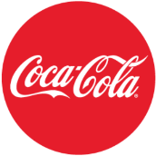


Summary – The Sweetspot Discovery
Contact details:
Phone: +41 79 768 65 08
E-Mail: cedric@potiio.ch
Cédric Sax
Co-Founder
Potiio’s bottle system
For a new taste, sense and wellness attitude – in water
69%
Are willing to buy Potiio’s bottle system according to our online-survey
Revenue CHF 69M
Expected in 2026
Raising CHF 1.25M
to scale-up and bring our product to market
Collaborations
Potential Partners

Slide 16


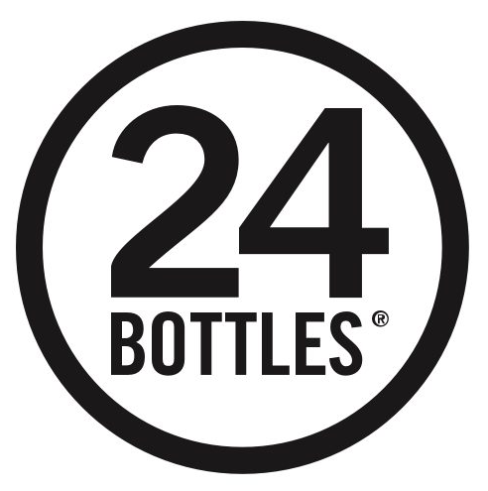



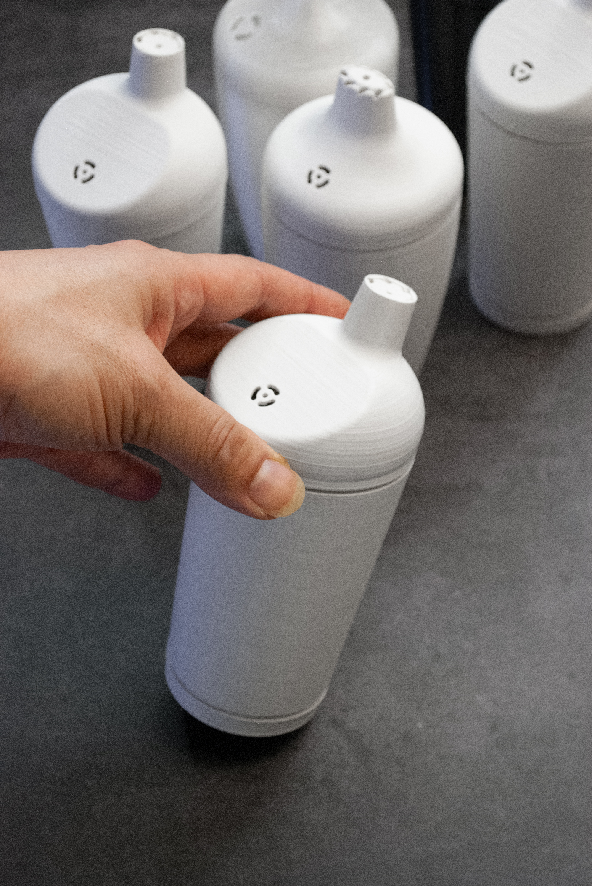














Supply chain & selling channels
Multiuse bottle producer
(metal)
Crowdfunding
Bottle-head / Capsule holder producer
Online sales
Collaborations
Capsule producer
Retail
Capsule filler and sealer
Flavor producer (drinks)

Slide 17
Market opportunity soft drinks – 2020
World
EU
CHF 687.6B
CHF 126.9B
D
CHF 21.5B
CH
CHF 3.3B
UK
CHF 28B
F
CHF 11B
statista.com / FX rate USD/CHF 0.93

Slide 18
Taste does not come with wellness
Worldwide status quo dehydration
Drink industry
Responds to needs with influx of sugared / soda water / artificial sweeteners in PET
TRANSFORM
The Sweetspot Discovery
Winning pledge:
Inspire to choose tap water for healthier hydration
Carbon impact:
Worldwide 1 million PET bottles are produced per minute
Health impact:
40% sugar intake are from drinks
Give sensation with mindful sugar, optimized by science
Be a planet hero, replace PET
who.int / statista.com / TK Trinkstudie
Notes:
Hydration should wow your senses

Slide 19
Go to Market – Millennials & Gen Z
Bottle and capsule technology
Millennials, Gen Z
Capsule & Flavors
Immersive E-Commerce
Marketable
Colors & aroma with clean water sensation. A novelty on the market.
Hustle culture, 24-7 on content & system, affinity with tech and daily wellness, fitness. Experiences over entertainment.
Nutrition solutions for reducing undesirable ingredients and adding health supporting nutrients.
Social Media Marketing, Paid content, blogging, online publications, landing-pages.
Supply Chain ready and at least three different capsule flavors.
- Q1 2022: 1000 bottles
with crowdfunding
- Q4 2022: test market
in CH with 3000 bottles.
Collaborations
Notes:
Unsere GTM-Strategie sieht wie folgt aus: Unser Prototyp steht und ist funktionstüchtig (inklusive Kapselsystem). Mit unserem Produkt wollen wir die Millennials und GenZ ansprechen. Dies aus den folgenden Gründen: Macher-Kultur, Tech-Affin, Gesundheits-Bewusst jedoch auch Geniesser und Zuckerliebhaber.
Mit unserer Kapsel-Vielfalt (5 verschiedene Sorten zu Beginn: - wie Cedric bereits am Anfang erklärt hat), wollen wir die potenziellen Kunden abholen. Dies machen wir mit einem grösseren E-Commerce unterfangen auf diversen Social Media Plattformen und über unser privates Netzwerk.
Über dies, wollen wir dann noch im Q1 2022 eine Crowdfunding Kampagne starten, bei welchem wir das Ziel haben, ca. 1000 Flaschen mit je 5 Kapseln zu verkaufen. Mit dieser ersten Traction wollen wir dann mit der Produktion beginnen, sodass wir den Kunden unsere Produkte im Q3 bereits zustellen können. Im Q4 wollen wir dann einen kleinen Teil im Retail Markt aufstellen, wo wir mit Migros bereits in Gesprächen sind.

Slide 20

Competitor Air Up and Dropz
Founded 2018
Founded 2020
Air pods with fragrance in drinking bottle without calories and sugar – OPPORTUNITY
Vitamin and aroma effervescent tablets which are dissolved in drinking water
  No calories and supplements
  No taste, just aroma
  160 FTE across EU
  4 funding rounds = USD 67.9M
  More than 1Mio customers 2021
  No calories and supplements
  Vitamin and natural flavors
  8 FTE in CH
  1 funding round = USD 2.7M
  Product launch in 2021
who.int / statista.com / TK Trinkstudie

Slide 21

A reusable drinking system with an innovative capsule system
1
Optimized volume of soft drink sirup
– Recyclable capsule
  Mouth model
2
Delayed release of pure water
– Reusable bottle
Tongue
3
Repeat for continuous drinking
Video link (15s)
  potiio bottle
– 40% Calories
Various capsule flavors
0% Artificial sweeteners
– 75% CO₂

Slide 22
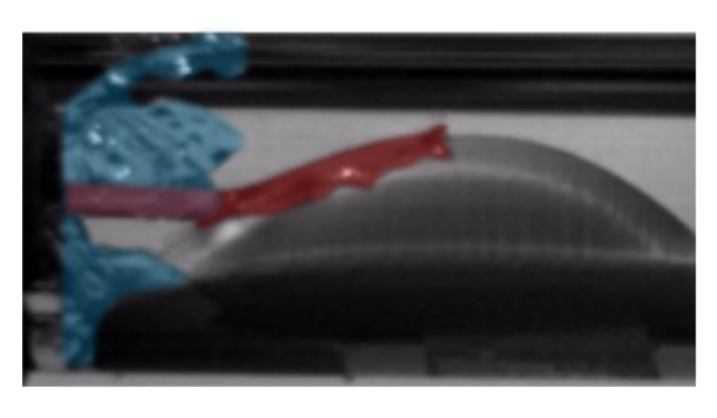
  Pure water
  Soft drink sirup
Tongue
Video link (15s)

Slide 23
Financial model summary
 |  |  | CHF Swiss Francs | 2021 | 2022 | 2023 | 2024 | 2025 | 2026
 |  |  | Total Revenue | 0 | 297’000 | 2’868’000 | 17’370’000 | 34’050’000 | 69’000’000
 |  |  | Total Direct Costs (COGS) | 270’000 | 1’347’200 | 2’162’040 | 7’298’400 | 13’966’000 | 22’950’000
Income |  |  | Gross Profit | - | -1’050’200 | 705’960 | 10’071’600 | 20’084’000 | 46’050’000
Statement |  |  | Total Operating Expenses (OPEX) | 10’000 | 164’250 | 942’000 | 4’832’500 | 9’702’500 | 19’100’000
Summary |  |  | Operating Income (Loss) | -280’000 | -1’214’450 | -236’040 | 5’239’100 | 10’381’500 | 26’950’000
 |  |  | Net Finance Expense | 0 | 0 | 0 | 0 | 0 | 0
 |  |  | Income Taxes | 0 | 0 | 0 | 0 | 726’705 | 1’886’500
 |  |  | Net Income (Loss) | -280’000 | -1’214’450 | -236’040 | 5’239’100 | 9’654’795 | 25’063’500
 |  |  | EBITDA (Loss) | -280’000 | -1’214’450 | -236’040 | 5’239’100 | 10’381’500 | 26’950’000
 |  |  | % |  | -409 | -8 | 30 | 30 | 39
 |  |  |  |  | *
 |  |  | Total Cashflow Operating Activities | -280’000 | -1’214’450 | -236’040 | 5’239’100 | 10’381’500 | 26’950’000
Cash Flow |  |  | Total Cashflow Investing Activities | 0 | 0 | 0 | 0 | 0 | 0
Summary |  |  | Total Cashflow Financing Activities | 280’000 | 1’250’000 | 500’000 | 0 | 0 | 0
 |  |  | Net Increase (Decrease) in Cash | 0 | 35’550 | 263’960 | 5’239’100 | 10’381’500 | 26’950’000
 |  |  | Closing balance | 0 | 35’550 | 299’510 | 5’538’610 | 15’920’110 | 42’870’110
* 2022 starts with 0 balance, acc. to InnoSuisse grant

